Slide 1
Evidence-based school reform: promise and realities
Gita Steiner-Khamsi, Professor
Teachers College, Columbia University, New York
Graduate Institute of International and Development Studies, Geneva
NORRAG, Director

Slide 2
1. Global Public Goods (GPGs)
2. Structural Coupling between Science & Politics
3. Coping with a Surplus of “Evidence”

Slide 3
1. Global Public Goods: The Concept
The transnational reach of problems and solutions:
Examples in education and international cooperation:
Clean environment
Property rights
Peace and security
Open access knowledge
International databanks
International toolkits
International best practices
Education GPS of OECD

Slide 4
1. Global Public Goods: The Debate
The Phenomenon:
Why “Numbers over Narrative”?
(W. Espeland, Radhika Gorur)
International databanks: global benchmarks and norm-setting
The global monitoring of national development (NORRAG special issue 04)
Governance by numbers (J. Ozga, S. Grek)
Governance by data circulation (Nelli Piattoeva et al.)
Seeing like PISA (Radhika Gorur)
Little national input as well as update at national level (see KIX EAP proposal)
decontexualization
recontextualization
For political usage

Slide 5
2. Structural Coupling between Science and Politics = Evidence-based Policy Planning
Science
Expert Commissions
Green Papers
Politics
Government Officials
White Papers

Slide 6
2. The Structural Coupling between 2 Function Systems
Politicization of Science
Scientization of Politics
Science
Expert Commissions
Green Papers
Politics
Government Officials
White Papers
Science
Expert Commissions
Green Papers
Politics
Government Officials
White Papers

Slide 7
Knowledge Production: Changes over Time
Scientific Advice in Policy-Making:
3 shifts since 1950s (Weingart & Lentsch)
2 Modes of Knowledge Production:
Gibbons et al. (1994) & Nowotny et al. (2003)
Expert commission insist on being autonomous independent of government, producing foundational scientific knowledge
Politicization of expert commissions, producing policy-relevant scientific knowledge
”Democratization” of scientific policy advice:
open-access to reviews and expertise,
expanding definition of “experts”
focus on usefulness of scientific policy advice
Foundational Research
Scientific problems
Peer review
Applied Research
Society problems
Outside control
Disciplinary
Multi-disciplinary
Theory versus praxis
Theory in practice

Slide 8
Two Modes of Knowedge
Mode 1 – Linear Research
Researchers
Frame Research 'question'
Data Collection
Analysis
Findings
Recommendations
'Uptake' and 'dissemination'
Time
Stakeholders
Mode 2 – Policy Relevant Research
Stakeholders
Frame Research 'question'
Analysis
Recommendations
Time
Researchers
Data Collection
Findings
'Uptake' and 'dissemination'

Slide 9
3. Coping with a Surplus of “Evidence”
“’evidence is assertion backed by information”
Source: Paul Cairney, 2015
Information
Numbers/
statistics
Comparison
Research
Affiliation of informant/author

Slide 10
The Surplus of Data (Chris Lubienski, 2018)
The Politics of Data Use
Drowning in Data, Thirsty for Analysis
Governance by Numbers
Coupling of Science & Politics
Notes:
No Child Left Behind Act of 2001: the “scientifically based” over 100 times (Chris Lubienski, 2018); Wallace Foundaiton study of 2016 -- 183 locally-based, cross-sector collaborations in education, 40 percent had a portion of their websites devoted to data (Carolyn Riehl, Jeff Henig, etc.); “the killer graph” in Sweden (Sotiria Grek); example: UNICEF advocacy brief

Slide 11
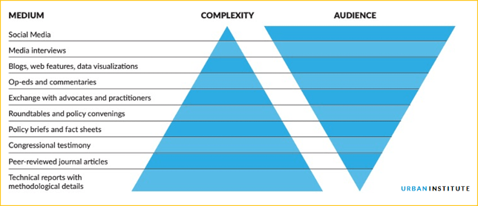
Practical Implication: Communication of Research

Slide 12
Practical Implications: From M&E to MEL: Meaning Making Meetings

Slide 13
The Surplus of Data & the Crisis of Expertise
Fast Lane
Law & regulations
Have the authority to make decisions
Middle Lane
Intermediaries/Brokers
Reframe data as evidence and translate research into policy
Slow Lane
Knowledge Producers
Pure science, academia, statistical agencies, sector research, etc.
Produce en masse without having to make a decision on how to act
Policy experts
Come across as facts
Proximate Decision Makers
Regulatory science
See Craft & Howlett, 2013 and also see Eyal, 2019
Notes:
OECD as a

Slide 14
Filtering and Hierarchization of “Information” in an Era of Data Surplus
 | Low Legitimacy for Policy Decisions | High Legitimacy for Policy Decisions
Type of Information | Narrative, opinion pieces, essays (exception: systematic literature reviews) | Data, numbers
Mode of Knowledge | Mode 1: scientific foundational research | Mode 2: applied policy research
Method of Inquiry of Policy Research | Qualitative, ethnographic | Quantitative, RCTs as “gold standard”, impact evaluations
Profession of author | Politicians | Scientists
Source of information | -- depends -- | International organizations: OECD, World Bank, UNICEF, UNESCO, etc.

Slide 15
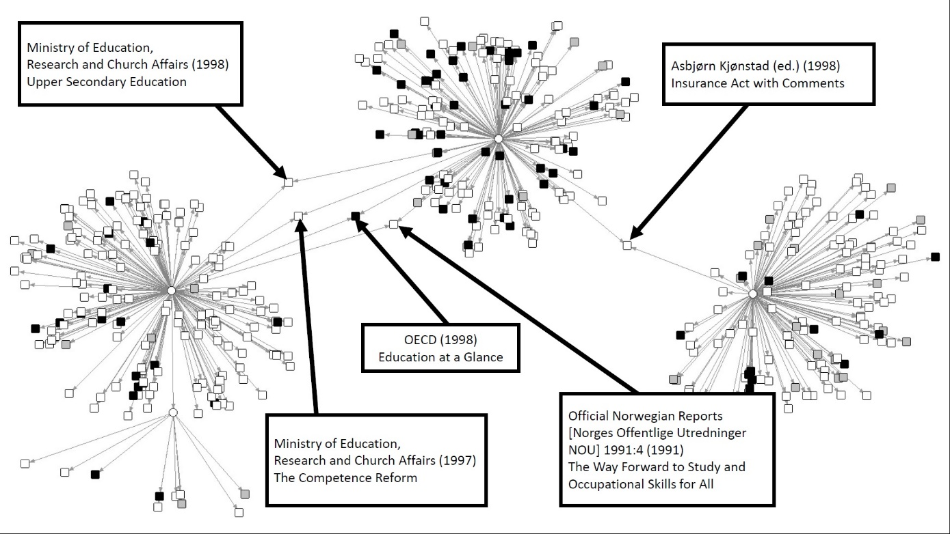
Source: Steiner-Khamsi, Karseth & Baek, 2019
Note: Regional=Grey; Domestic=White; International=Black; Source=Circle; References=Square

Slide 16
OECD Reception: Qualitative Analysis
Norwegian adaptation of OECD’s DeSeCo (Definitions and Selections of Competencies)

Slide 17
Governance in an era of global public goods
Polycentric governance
National Ministry of Education
OECD/
World Bank
Interest Groups (private sector, civil society, etc.)
National Cabinet/
Presidential Office

